Slide 1
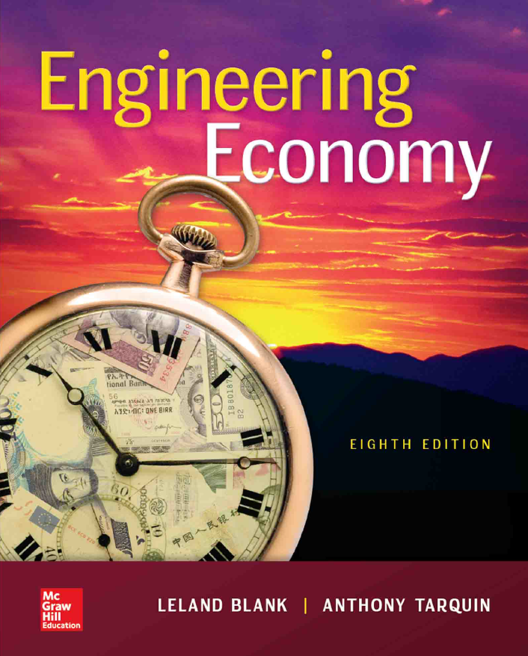

Chapter 6
Annual Worth Analysis
Lecture slides to accompany
Engineering Economy
8th edition
Leland Blank
Anthony Tarquin
6-<number>

Slide 2
LEARNING OUTCOMES
Advantages of AW
Capital Recovery and AW values
AW analysis
Perpetual life
Life-Cycle Cost analysis
6-<number>

Slide 3


Advantages of AW Analysis
AW calculated for only ____ life cycle
AW = PW(A/P, i, n) = FW(A/F, i, n)
It is not necessary to use the ____ of lives to satisfy the equal-
Service requirement
All cash flows will be _____ in every life cycle
6-<number>

Slide 4
Alternatives usually have the following
cash flow estimates
Initial investment, P – ______ cost of an asset
Salvage value, S – Estimated value of asset at ____ of useful life
Annual amount, A – Cash flows associated with asset, such
as __________________ cost (AOC), etc.
Relationship between AW, PW and FW
AW = PW(A/P,i%,n) = FW(A/F,i%,n)
n is years for equal-service comparison (value of LCM or specified study period)
6-<number>

Slide 5

Calculation of Annual Worth
AW for one life cycle is the ____________life cycles!!
An asset has a first cost of $20,000, an annual operating
cost of $8000 and a salvage value of $5000 after 3 years.
Calculate the AW for one and two life cycles at i = 10%
AW_{one} = - 20,000(A/P,10%,3) – 8000 + 5000(A/F,10%,3)
= $-14,532
AW_{two} = - 20,000(A/P,10%,6) – 8000 – 15,000(P/F,10%,3)(A/P,10%,6)
+ 5000(A/F,10%,6)
= $-14,532
6-<number>

Slide 6
Capital Recovery and AW
Capital recovery (CR) is the ________ _______ amount that an asset, process, or system must earn each year to just recover the _____ cost and a stated rate of return over its expected life. Salvage value is considered when calculating CR.
CR = -P(A/P,i%,n) + S(A/F,i%,n)
Use previous example: (note: ______ not included in CR )
CR = -20,000(A/P,10%,3) + 5000(A/F,10%,3) = $ – 6532 per year
Now AW = CR + ___
AW = – 6532 – 8000 = $ – 14,532
6-<number>

Slide 7
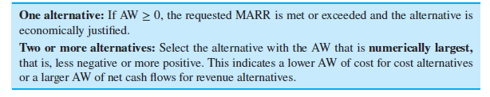
Selection Guidelines for AW Analysis
6-<number>

Slide 8
ME Alternative Evaluation by AW
Not necessary to use LCM for different life alternatives
A company is considering two machines. Machine X has a first cost of $30,000, AOC of $18,000, and S of $7000 after 4 years.
Machine Y will cost $50,000 with an AOC of $16,000 and S of $9000 after 6 years.
Which machine should the company select at an interest rate of 12% per year?
Solution:
AW_{X} = -30,000(A/P,12%,4) –18,000 +7,000(A/F,12%,4)
= $-26,412
AW_{Y} = -50,000(A/P,12%,6) –16,000 + 9,000(A/F,12%,6)
= $-27,052
Select Machine ___; it has the numerically _________AW value
6-<number>

Slide 9
AW of Permanent Investment
Use A = Pi for AW of ____________ life alternatives
Find AW over _____life cycle for finite life alternatives
Compare the alternatives below using AW and i = 10% per year
C D
First Cost, $ -50,000 -250,000
Annual operating cost, $/year -20,000 -9,000
Salvage value, $ 5,000 75,000
Life, years 5 ∞
Solution: Find AW of C over 5 years and AW of D using relation A = Pi
AW_{C} = -50,000(A/P,10%,5) – 20,000 + 5,000(A/F,10%,5)
= $-32,371
AW_{D} = Pi + AOC = -250,000(0.10) – 9,000
= $-34,000
Select alternative C
6-<number>

Slide 10
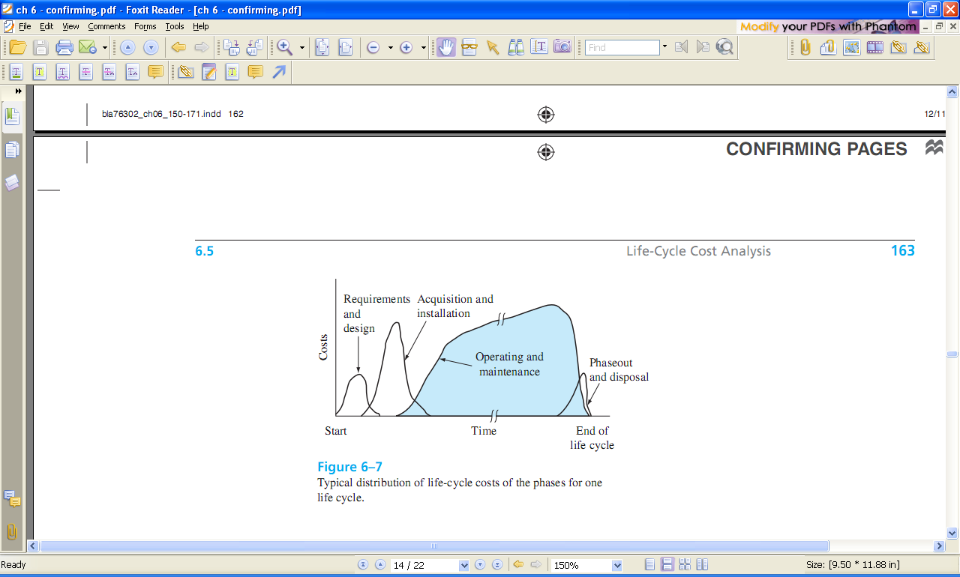
Typical Life-Cycle Cost Distribution by Phase
6-<number>

Slide 11
Life-Cycle Cost Analysis
LCC analysis includes ___ costs for ______ life span,
from concept to disposal
Best when large percentage of costs are _______
Includes phases of ________, ________, & _________
Apply the AW method for LCC analysis of 1 or more cost alternatives
Use PW analysis if there are revenues and other benefits considered
6-<number>

Slide 12
Summary of Important Points
AW method converts all cash flows to ______ value at ______
Alternatives can be mutually exclusive, independent,
revenue, or cost
AW comparison is only _____ life cycle of each alternative
For infinite life alternatives, annualize initial cost as A = ____
Life-cycle cost analysis includes ____ costs over
a project’s life span
6-<number>

Slide 13
HOMEWORK
Please solve every Examples in your textbook. You do not have to submit your works.
Please upload following “PROBLEMS” solution file on “Assignment” menu in e-Class.
  6.7
  6.16
  6.31
  6.36
  6.49
4-<number>

